Slide 1
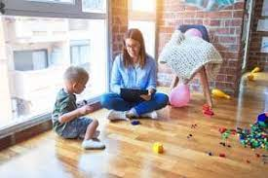
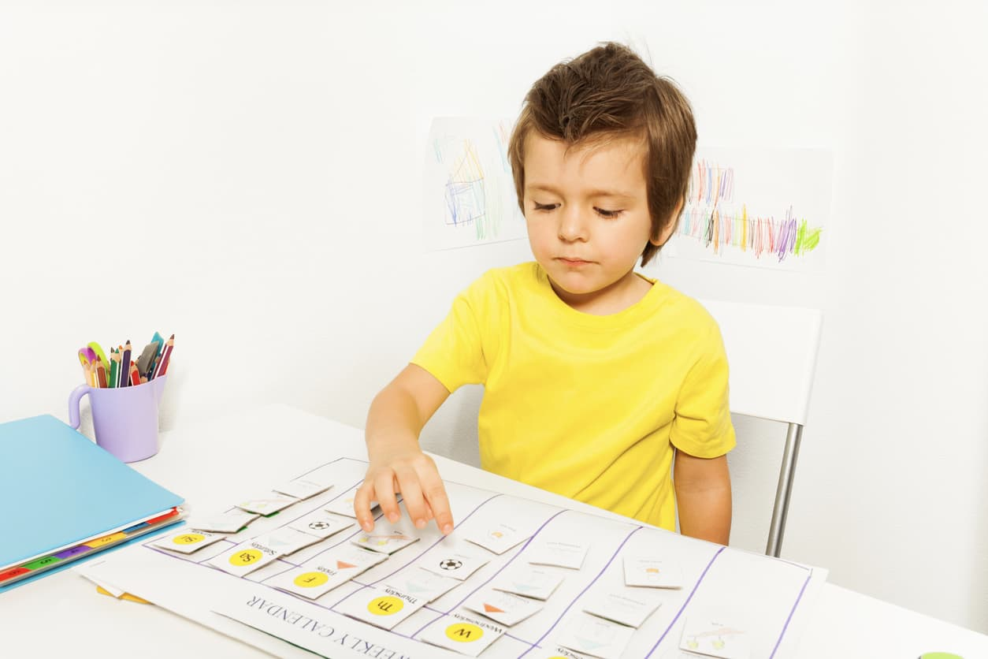
Strategies to Help Your Child with Autism
at Home
Presented By: Laura Villa

Slide 2
STRUCTURE AND PREDICTABILITY
Creating Routines
All children learn best with repetition and routines. Consistent routines
Comfort and consistency (patterns, rhythm)/ calm/self-regulation
Environment more predictable (Child knows exactly what to expect. Less anxiety // safe, secure and confident).
Gain understanding of everyday events and activities.
Understand expectations (the child knows when “play time” and “eating time” are).
More compliant (cooperate more and complete activities with less transition issues).
Children complete more tasks independently.
Calmer household

Slide 3
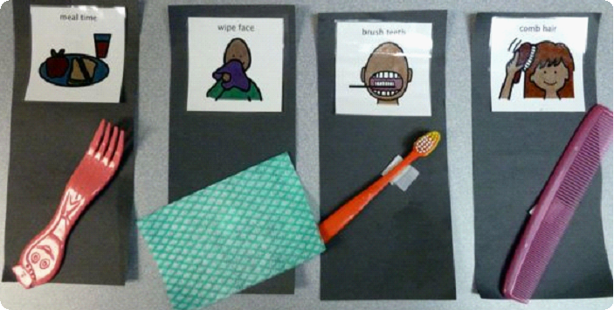
Creating Routines
Using Visual Supports
Visual learners
Help communicate with a child with language difficulty. (Powerful tools of communication).
Provide support and structure
Visual supports can be pictures, words, objects, symbols, etc.

Slide 4
Home Visual Schedule
- Provides a sequence of activities that
shows the child what’s going to happen
throughout the day or within a task or
activity.
- A visuals schedule/routine is used to
break down a large activity into smaller
more manageable steps.

Slide 5
Change / Special Activity Card
If the change is unexpected, place card on top of the picture you need to change
If the change is already planned, place the card instead of the activity that you had initially planned

Slide 6
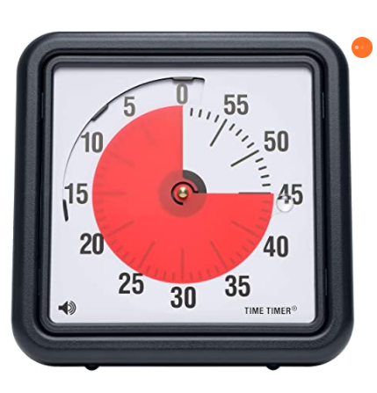
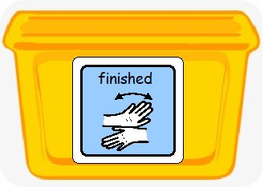
Visual Timer and Finished Bin
- Help with transitions (playing with favorite toys or items).
- Child learns to put away and move on to next activity.
- Use along with the timer to let your child know how long they have
with toy or item. When timer beeps help child place item into the
bin while saying “playing is finished”

Slide 7
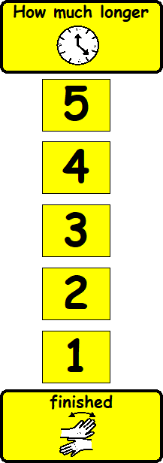
Visual Count Down
The visual count down
represent approximate
intervals of time.
It includes numbers in a
descending order which are
individually removed as time
passes.
- Signals end of an activity and time to move onto next one
Differs from timer in that with a visual countdown the period of time is not precise but can be manipulated depending on the circumstances.

Slide 8
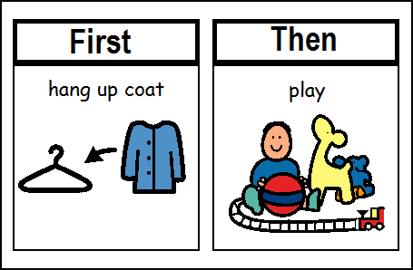
First – Then Board
Help children engage
In a less preferred
Activity when they see they will get to do something they enjoy afterward.

Slide 9
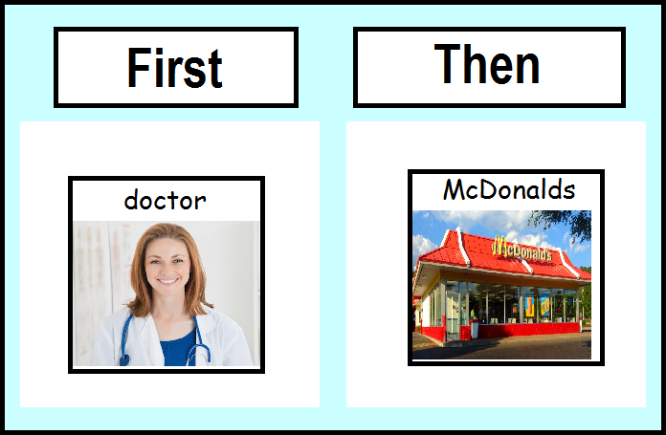
First-Then Boards

Slide 10
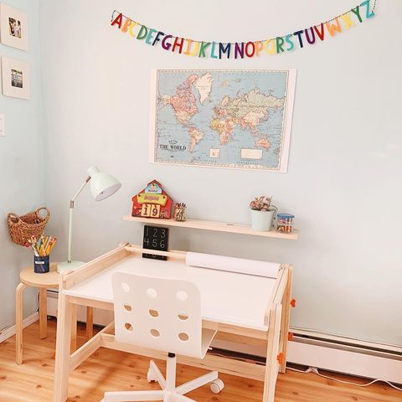
Other Things You Can Do
Be consistent: Creating consistency in your child’s environment
is the best way to reinforce learning.
Setup organized, uncluttered,
cozy, inviting spaces
Activities should take place
in appropriate predictable spaces.
(meals in the dinning room, reading-writing in a
small table, TV in the living room, etc.)
Stick to a schedule. Try to keep disruptions to the routine to a
minimum. If there is an unavoidable schedule change, prepare
your child for it in advance.

Slide 11
Reward good behavior
Positive reinforcement
Praise them when they act appropriately or learn a new skill, (being very specific about what behavior they’re being praised for).
Other ways to reward good behavior: a sticker or letting them play with a favorite toy.

Slide 12
Connecting With Your Child
Your child is communicating with you, even if he or she never speaks.
You just need to learn their language.
- Look for nonverbal cues: sounds they make, facial expressions,
gestures they use when they’re tired, hungry, or want something.
- Figure out motivation of tantrum.
- Make time for fun: Schedule playtime when your child is most alert and
awake. (Figure out things that make your child smile, laugh, and come out
of her/his shell.)
Your child is likely to enjoy these activities most if they don’t seem therapeutic or educational. Spend unpressured time with your child
Play is an essential part of learning for all children and shouldn’t feel like work.

Slide 13
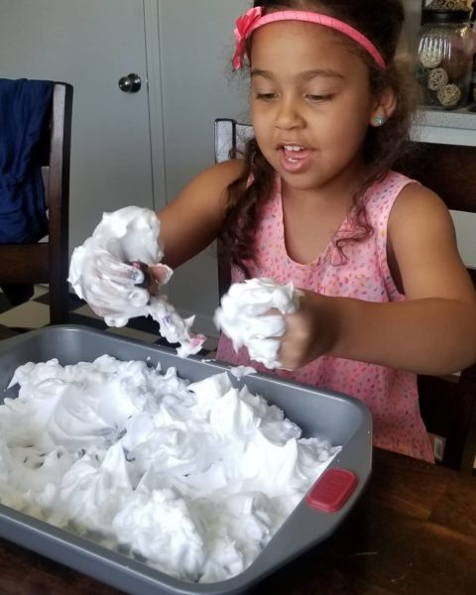
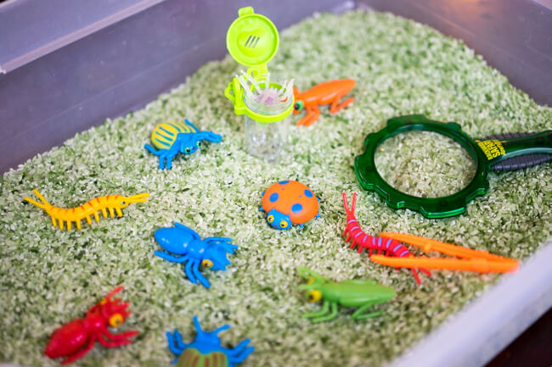
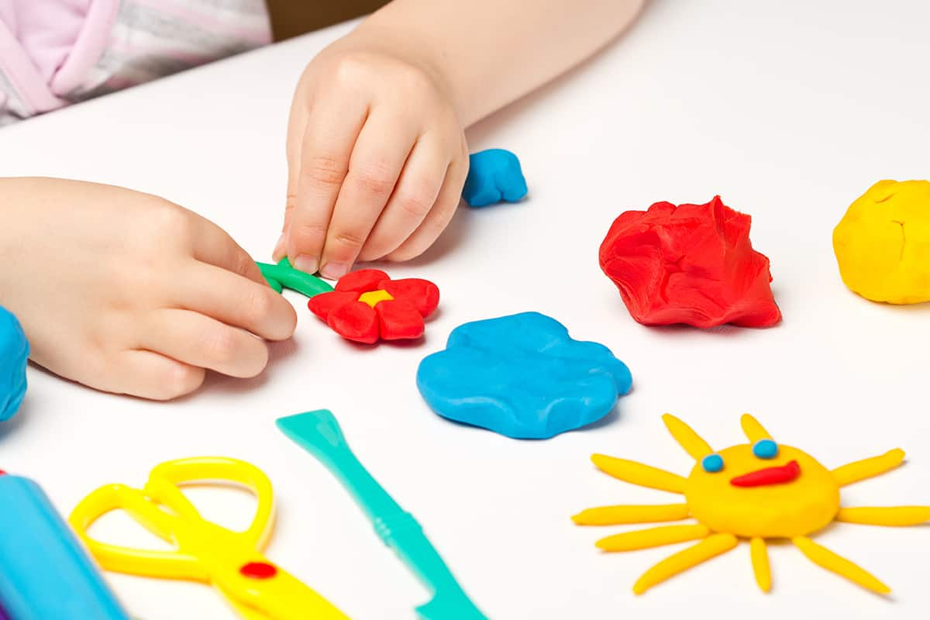
Sensory Activities - Sensory Bins
Make play dough: 2 cups plain flour, 1 cup salt, ½-1 cup cold water, 1 T oil, and 2 drops of food coloring, if desired. Combine flour, salt, water,
food coloring and oil. Mix and knead until well formed

Slide 14
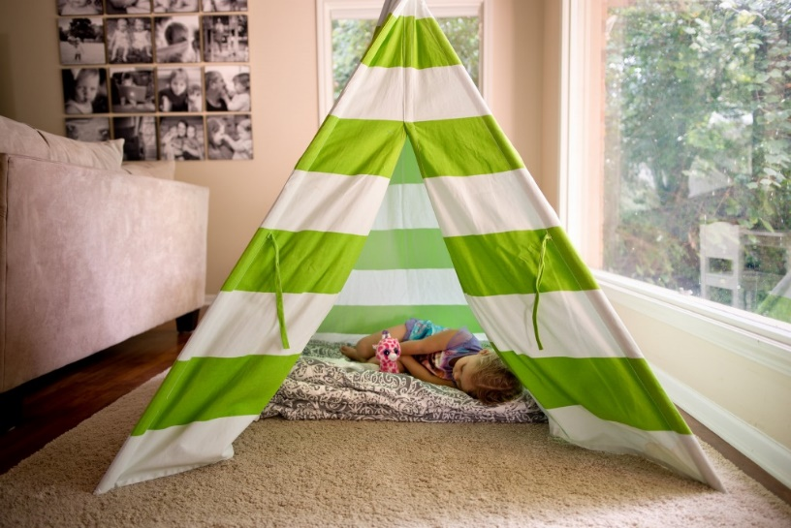
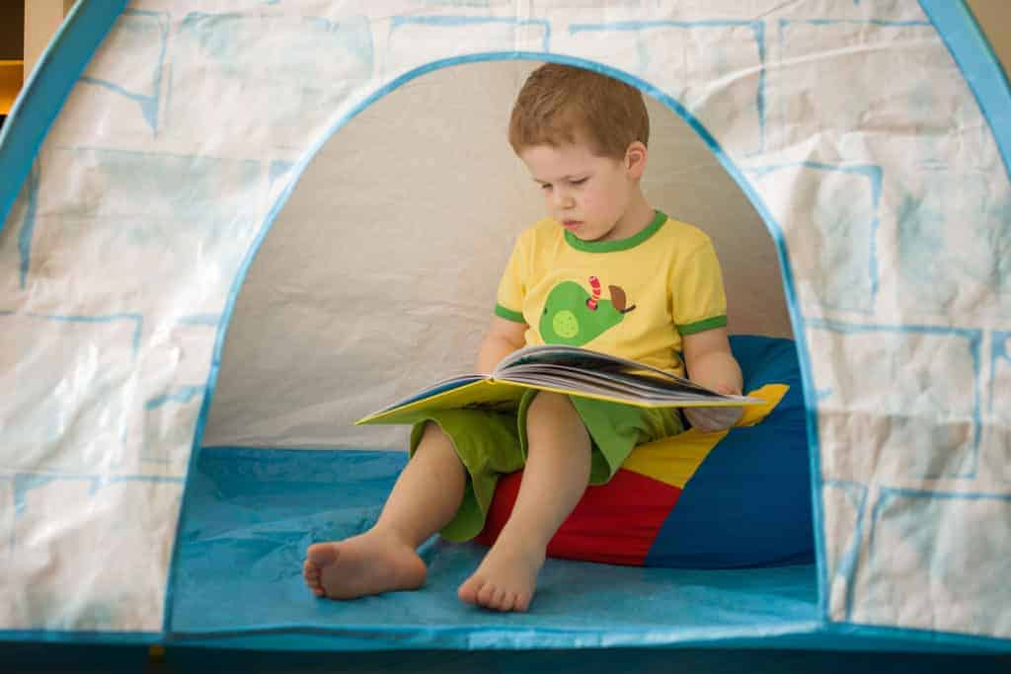
Pay attention to your child’s sensory sensitivities: Many are hypersensitive (light, sound, touch, etc.) some are “under-sensitive” to sensory stimuli. Others are both (mixed).
Figure out sights, sounds, smells, movements, and tactile sensations trigger your kid’s “bad” or disruptive behaviors and what elicits a positive response; Stressful? Uncomfortable? Calming? Enjoyable?
Create a home safety zone: Create a cozy - private space in your home where your child can relax, feel secure, and be safe.

Slide 15
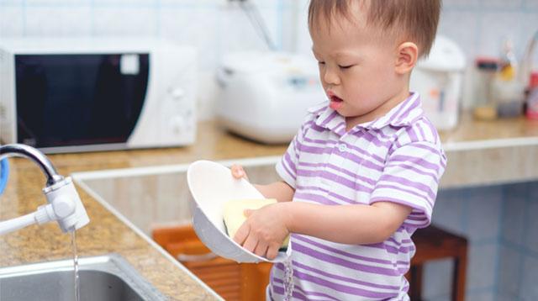
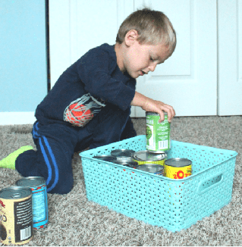
Providing Needed Sensory Input
Through House Chores
- Keep them occupied
- Teach them daily living skills

Slide 16
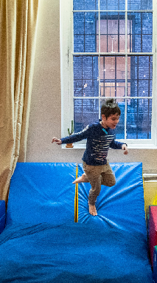
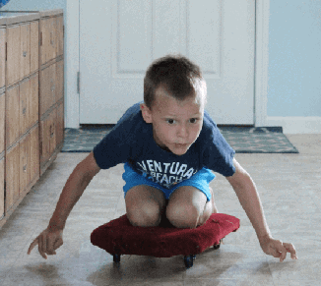
Create opportunities for movement:
Help improve mood and attention as well as reduce anxiety.
Incorporate time for exercise every day: walk, bike ride, climbing at the park, etc.
If it’s too cold for outdoor activities, try bouncing on exercise ball, jumping on a trampoline, or following an exercise routine from a video or YouTube.

Slide 17
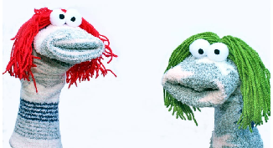
Other Fun Activities
Peek-a-boo
Bubbles
Puppet show
Impromptu dance party
Hide and seek in the house

Slide 18
HAVE FUN WITH
YOUR CHILD!
and
BE
CREATIVE

